Slide 1


Project 3 no wait 2 or maybe it's 3
Ash, Patty, Rosa, Tu Cam, Vik

Slide 2
Agenda
Using Akashfu this assignment was put together
Setting up MongoDB database
Connecting to Flask
Establishing website dashboard
Updated the database
Set up various visualizations
Not presenting the dashboard instead presenting a powerpoint
Had fun and ranted on

Slide 3
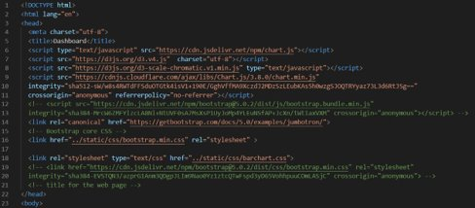
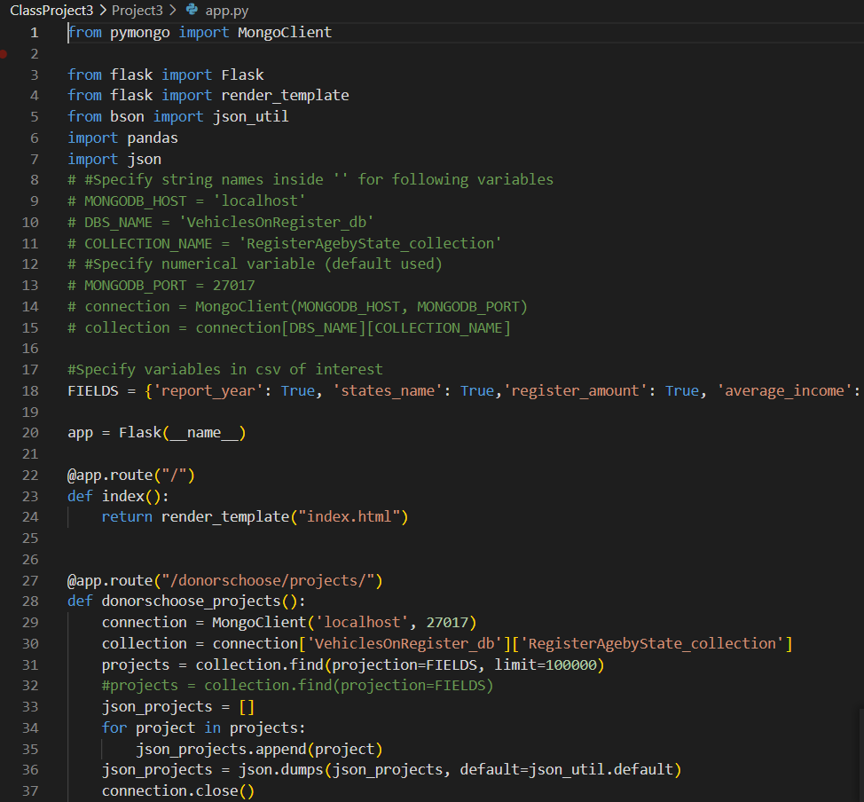
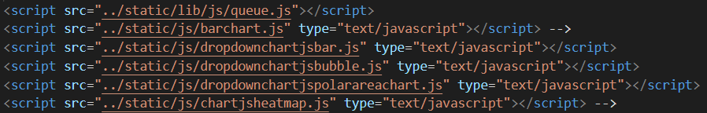
Html Setup + Flask Connection

Slide 4
Dashboard – bar chart

Slide 5
Dashboard – line chart

Slide 6
Dashboard – bubble chart

Slide 7
Thanks for listening

